Slide 1
Scientific Programming
Ankara University
Computer Engineering Department

Slide 2
Scientific Programming
MATRIX
Ankara University
Computer Engineering Department

Slide 3
Vector
A vector is a column of numbers consisting of n numbers
 | a₁
 | a₂
 | a₃
 | ...
 | a_{n}
The values shown by a_{i} are the elements of vector a.
A =

Slide 4
Matrix (Pl.: Matrices)
A matrix
is a rectangular array of numbers consisting of m rows and n columns.
 | a₁₁ | a₁₂ | ... |  |  | a_{1n}
 | a₂₁ | a₂₂ | ... |  |  | a_{2n}
 | ... | ... | ... |  |  | ...
 | a_{m1} | ... | ... |  |  | a_{mn}
The values shown by a_{ij} are the elements of vector a.

Slide 5
Matrix example
 | 2 | 5 | 7 | 8
 | 5 | 6 | 8 | 3
 | 1 | 6 | 4 | 0
This matrix has 3 rows rows and 4 columns.
We say it is a 3 x 4 (3 by 4) matrix.
We denote the element on the second row and fourth column with a_{2,4}

Slide 6
Subscripted expression
Elements are denoted using the indexed notation:
a_{i,j}
Subscripted expression
Row index
Column index

Slide 7
"Matrices of the same kind"
Matrices A and B are of the same kind if and only if
A has as many rows as B, and
A has as many columns as B
A_{MN} B_{MN} are of the same kind.
We may often say that A and B are "of the same order."

Slide 8
Special Matrices
Row/column matrices
Zero matrix
Square matrix
Diagonal matrix
Unit matrix
Symmetric matrix
Transpose
Orthogonal matrix

Slide 9
Row matrix / column matrix
A matrix with one row is called a row matrix.
 | 0 | 0 | 0 | 0
 | 0
 | 0
 | 0
A matrix with one column is called a column matrix.
Also called: row-vector and column-vector.

Slide 10
Zero Matrix
A zero matrix is a matrix with all elements 0.
 | 0 | 0 | 0
 | 0 | 0 | 0
 | 0 | 0 | 0
 | 0 | 0 | 0 | 0
 | 0 | 0 | 0 | 0

Slide 11
Square Matrix
A square matrix has the same number of rows and columns.
 | 2 | 5 | 7
 | 5 | 6 | 8
 | 1 | 6 | 4
The elements a_{i,i} , with i = 1,2,3,... are called diagonal elements.

Slide 12
Diagonal matrix
A diagonal matrix is a square matrix with all non-diagonal elements 0.
 | 2 | 0 | 0
 | 0 | 6 | 0
 | 0 | 0 | 4

Slide 13
Unit matrix
A unit matrix is a diagonal matrix with all diagonal elements 1.
 | 1 | 0 | 0
 | 0 | 1 | 0
 | 0 | 0 | 1
Also called: identity matrix - I.

Slide 14
Symmetric matrix
A symmetric matrix is a square matrix where a_{I, J} = a_{J, I} for all elements.
 | 1 | -1 | 4
 | -1 | 2 | 3
 | 4 | 3 | 6

Slide 15
Transpose
The transpose of the m x n matrix A is shown by A^{T}.
A^{T} is an n x m matrix,
row i of A = column i of A^{T} for (i = 1,2,3, .. n)

Slide 16
Transpose (2)
1
2
3
4
A =
5
6
7
8
9
10
11
12
1
5
9
2
6
10
A^{T} =
3
7
11
4
8
12

Slide 17
Transpose (3)
Matrix A' is the transpose of matrix A if and only if :
The i^{th} row of A = the i^{th} column of A'
for (i = 1,2,3,..n)
Transposing a matrix means converting and m x n matrix into an n x m matrix, by “flipping” the rows and columns.

Slide 18
Transpose (4)
 | 2 | 5 | 7 | 8
 | 5 | 6 | 8 | 3
 | 1 | 6 | 4 | 0
4 x 3
2
5
1
3 x 4
5
6
6
7
8
4
8
3
0

Slide 19
Transpose (5)
 | 1 | 2 | 3
 | 4 | 5 | 6
 | 7 | 8 | 9
3 x 3
1 | 4 | 7
3 x 3
2 | 5 | 8
3 | 6 | 9

Slide 20
Orthogonal matrix
An orthogonal matrix is a square matrix which produces a unit matrix if it is multiplied by its own transpose:
A × A^{T} = I

Slide 21
Properties of special matrices
A = (A^{T})^{T} = (((A^{T})^{T} )^{T} )^{T}
(A + B)^{T} = (A^{T} + B^{T})
If A is a symmetric matrix, then A = A^{T}
If A is an orthogonal matrix, then A × A^{T} = I

Slide 22
Matrix Algebra
Scalar multiplication
Matrix addition
Matrix subtraction
Vector addition
Vector multiplication
Matrix multiplication

Slide 23
Scalar multiplication
To multiply a matrix by a number k, multiply each element of the matrix by the number k.
2
3
 | 4 | 6
 | 10 | 12
 | 2 | -2
2 ·
5
6
=
1
-1

Slide 24
Matrix addition
To add two matrices, add elements of the first to the corresponding element of the second.
2
3
-1
2
1
5
5
6
+
0
3
=
5
9
1
-1
2
-2
3
-3
!!! Addition is possible if matrices are of the same order.

Slide 25
Matrix subtraction
A - B : To subract a matrix B from A, subtract elements of B from the corresponding element of A.
2
3
-1
2
3
1
5
6
-
0
3
=
5
3
1
-1
2
-2
-1
1
!!! Subtraction is possible if matrices are of the same order.

Slide 26
Vector addition
To add two vectors, add the corresponding elements.
The result is a vector of the same size.
1
2
 | 3
 | 3
 | 3
-1
+
4
=
3
0
!!! Addition is possible if vectors are of the same size.

Slide 27
Vector multiplication
You can multiply a row vector with a column vector.
To multiply two vectors, multiply the corresponding elements, then add the results.
The result is a single number.

Slide 28
Vector multiplication (2)
Multiply the corresponding elements, then add the results
2
 | 1 | -1 | 3
×
4
=
2 +(- 4) + 0 = 2
0
!!! Multiplication is possible if vectors are of the same order.

Slide 29
Matrix multiplication
Let A be a k x m matrix and
B be an m x n matrix,
Then the product A × B = C is defined.
C is a k x n matrix.

Slide 30
Matrix multiplication
A_{KM} × B_{MN} = C_{KN}
The number of rows of C is equal to that of A, (which is K)
The number of columns of C is equal to that of B (which is N).

Slide 31
Matrix multiplication
•
•
•
•
•
. | • | •
 | • | •
×
•
•
⇒
•
•
•
•
•
•
•
. | • | • | •
 | • | • | •
 | • | • | •
•
•
•
•
•
×
⇒
•
•
•
•
•
!!! AB ≠ BA (Unless A, B are both NxN)

Slide 32
Matrix multiplication (2)
Element c_{i j} is the vector product of row i with column j.
•
•
•
•
•
•
•
×
•
•
=
•
•
•
•
•
•
•

Slide 33
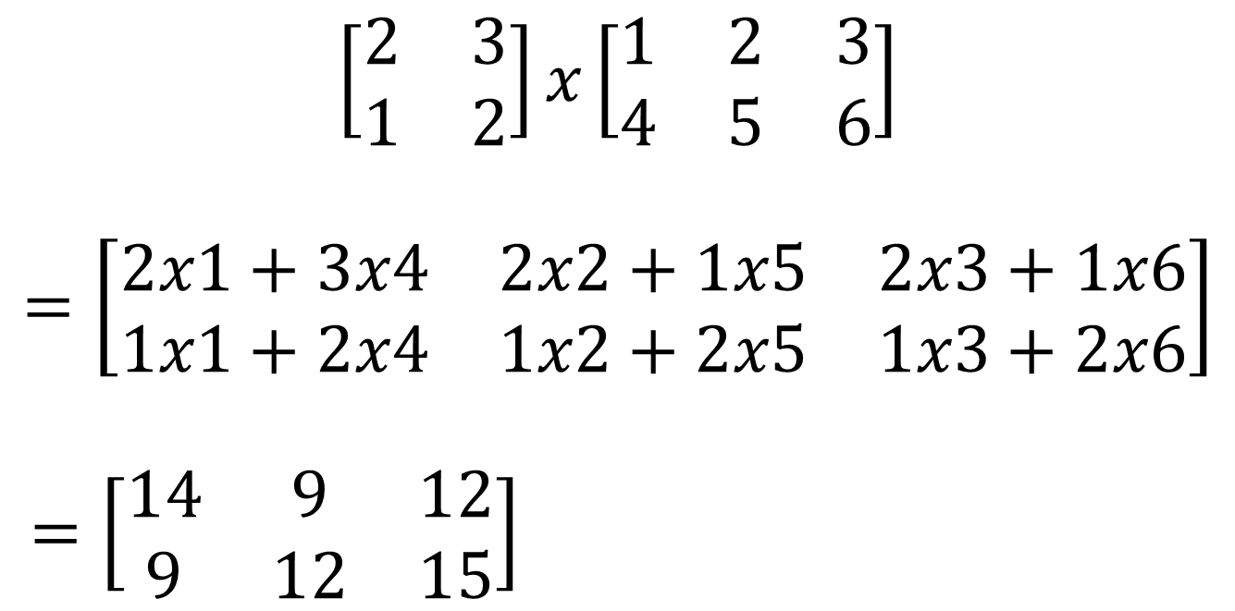
Matrix multiplication (3)

Slide 34
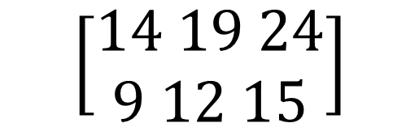
Matrix multiplication (3)

Slide 35
Properties of matrix addition
Addition is associative:
A+B+C = (A+B) + C = A + (B+C)
A + 0 = A = 0 +A (0: zero matrix)
Addition is symmetric: A + B = B +A

Slide 36
Properties of Scalar multiplication
(k, s scalar numbers)
k (A+B) = kA + kB
(k+s) A = kA+sA
(ks) A = k (sA)
(kA)^{T} = k A^{T}

Slide 37
Properties of Matrix multiplication
Multiplication is associative:
A×B×C = (A×B) × C = A × (B×C)
Multiplication is distributive:
A×(B +C) = A×B + A×C
(A×B)^{T} = B^{T} × A^{T}
A×0 = 0×A = 0 (0 is the zero matrix)

Slide 38
Inverse of a matrix
Let A and B be a square matrix.
  AB = I =BA B is inverse of A.
The inverse of matrix A is shown by A⁻¹
By definition, AA⁻¹ = A⁻¹A = I, where I is the identity matrix.

Slide 39
Determinant of a matrix
⏐A⏐ is called the determinant of matrix A.
Sometimes written also as: det(A)
When computed, ⏐A⏐ turns into a single number.
We'll see how ⏐A⏐ can be computed in a short while.

Slide 40
Finding the inverse of a matrix
Only square matrices have inverses.
To find the inverse of A , ... you need to find ⏐A⏐.
To find the determinant ⏐A⏐, ... you need to find the cofactors of elements of A.
... you need to find the minors of A

Slide 41
Finding minor of element a_{ij}
The minor A_{ij} is the matrix obtained by deleting row i and column j of A.
. | • | • | •
 | • | • | •
 | • | • | •
Minor(A₁₂) =

Slide 42
Finding cofactor of element a_{ij}
The cofactor for minor A_{ij} is
Cofactor C_{ij} = (-1)^{i+j} ⏐minor(A_{ij})⏐
We need to find the cofactor matrix C computing C_{ij} for each A_{ij} .
(This is a recursive process)

Slide 43
Finding the inverse of A
The inverse of A:
A⁻¹ = 1/⏐A⏐ C^{T}
Note that ⏐A⏐ is a number
... so is 1 / ⏐A⏐ .

Slide 44
Finding the determinant of a 2x2 matrix
⎡
a
a
⎤
a
a
det
11
12
=
11
12
⎢
⎥
⎣
a
a
⎦
a
a
21
22
21
22
=
a
a
−
a
a
11
22
21
12

Slide 45
Finding the cofactor matrix of a 2x2 matrix
⎡
a
−
a
⎤
22
21
Cofactor (A) =
⎢
⎥
−
a
a
⎣
⎦
12
11
Found by eliminating rows and columns of A
⎡
a
a
⎤
11
12
⎢
⎥
⎣
a
a
⎦
21
22

Slide 46
Finding the inverse of a 2x2 matrix
−
1
⎡
a
a
⎤
11
12
=
⎢
⎥
⎣
a
a
⎦
21
22
⎡
a
−
a
⎤
1
22
12
⎢
⎥
a
a
−
a
a
−
a
a
⎣
⎦
11
22
21
12
21
11

Slide 47
Finding the determinant of a 3x3 matrix
⎡
a
a
a
⎤
11
12
13
⎢
⎥
det
a
a
a
=
⎢
21
22
23
⎥
⎢
a
a
a
⎥
⎣
⎦
31
32
33
a
a
a
a
a
a
a
22
23
−
a
21
23
+
a
21
22
11
a
a
12
a
a
13
a
a
32
33
31
33
31
32

Slide 48
Properties of determinants
A matrix A and its transpose have the same determinant: ⏐A⏐ = ⏐A^{T}⏐
The determinant of a diagonal matrix is the product of the diagonal elements.
When we exchange two columns in A, or, when we exchange two rows in A, |A| changes sign.

Slide 49
Linear equations
A system of n equations, with n unknowns.
a₁₁ x₁ + … + a_{1n} x_{n} = b₁
a₂₁ x₁ + … + a_{2n} x_{n} = b₂
:
a_{n1} x₁ + … + a_{nn} x_{n} = b_{n}

Slide 50
Linear equations (2)
Can be written as a matrix equation:
A X = B
a₁₁
...
a_{1n}
x₁₁
b₁₁
a₂₁
...
a_{2n}
x₂₁
b₂₁
A=
X=
B=
...
...
...
...
...
a_{n1}
...
a_{nn}
x_{n1}
b_{n1}

Slide 51
Linear equations (3)
If the determinant |A| is nonzero, the equation can be solved to produce n numerical values for x that satisfy all the simultaneous equations
Find A⁻¹ (the inverse of A) (it must exist because |A| is nonzero)
Multiply both sides of the equation by A^{-1:}
A⁻¹A X = A⁻¹ B
Since A⁻¹ A = I :
X = A⁻¹ B

Slide 52
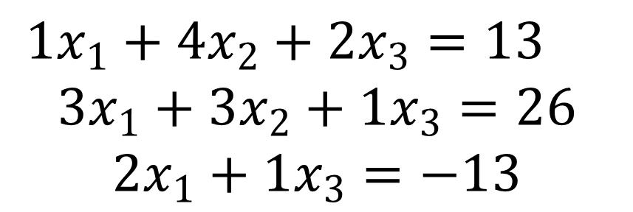
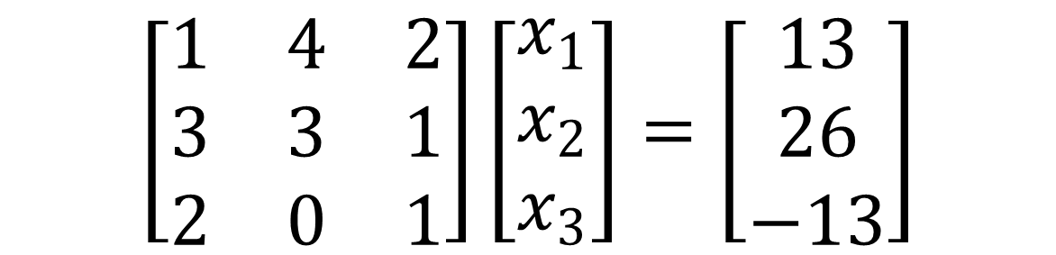
Linear equations (3) Example 1

Slide 53
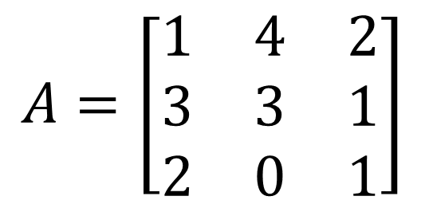
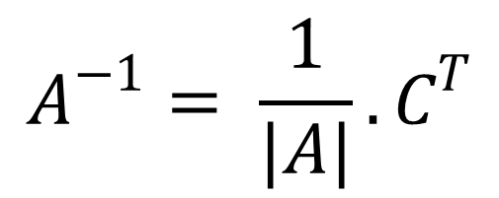
a
a
a
a
a
a
a
22
23
−
a
21
23
+
a
21
22
11
a
a
12
a
a
13
a
a
32
33
31
33
31
32
3
1
3
1
3
3
=
1
−
4
+
2
0
1
2
1
2
0
= 3 – 4 – 12 = – 13

Slide 54
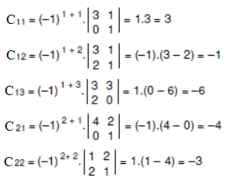
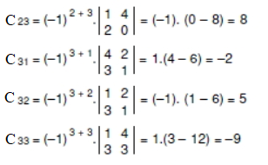
C_{ij} = (-1)^{i+j} ⏐minor(A_{ij})⏐

Slide 55
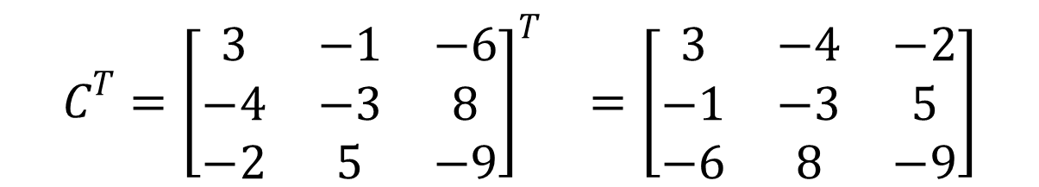
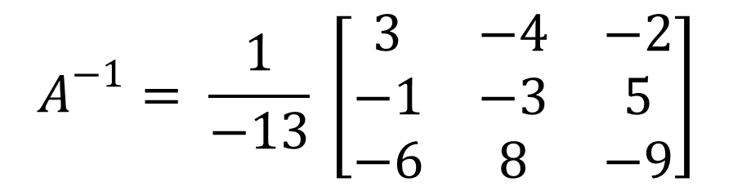

Slide 56
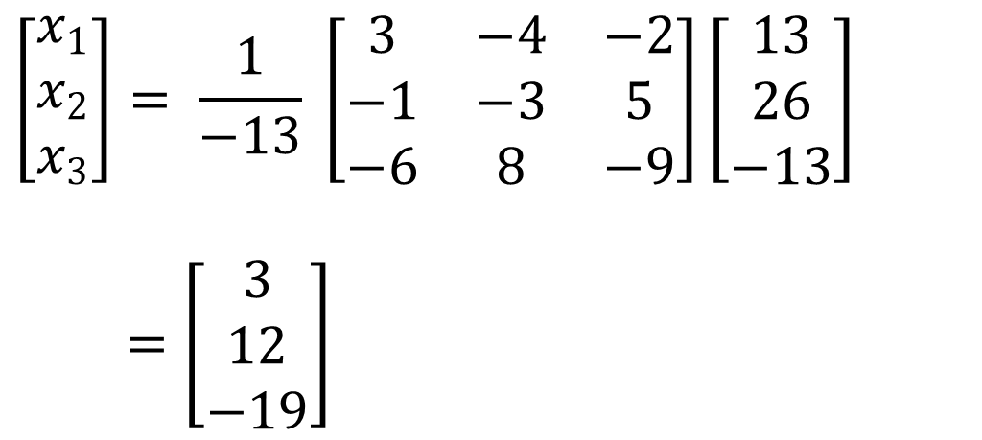
X = A⁻¹ B

